Slide 1
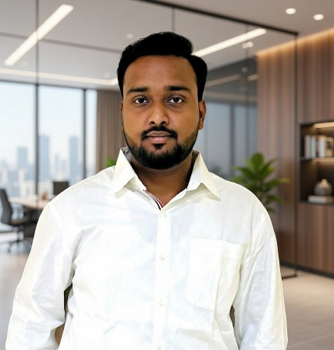
Plan Today Prosper Tomorrow
Kunal Gupta
AMFI Registered Mutual Fund Distributer
ARN – 353508 | Phone: 8434463048
Kunalkr.gupta5@gmail.com
MBA-Finance | NISM-VA | NISM XV | BBA

Slide 2
WHAT IS A MUTUAL FUND?
Slide 02
Pool. Invest. Grow.
A Mutual Fund pools money from thousands of investors and invests it in stocks, bonds, or other assets — managed by a professional Fund Manager. Think of it as a "dabbawala system" — everyone contributes, a professional handles delivery, and everyone benefits proportionally.
01
02
03
04
Investors Contribute
Fund Manager Invests
Portfolio Grows
You Earn Returns
You invest ₹500 or more via SIP or lumpsum
Expert allocates across 30–50 securities
Returns generated through dividends & capital gains
NAV rises; you redeem anytime (open-ended funds)
🇮🇳 Indian Example: SBI Blue Chip Fund pools ₹40,000+ Crore from lakhs of investors, managed by experienced fund managers — giving individual investors access to top 100 companies.
Mutual Fund investments are subject to market risks. Read all scheme related documents carefully before investing.

Slide 3
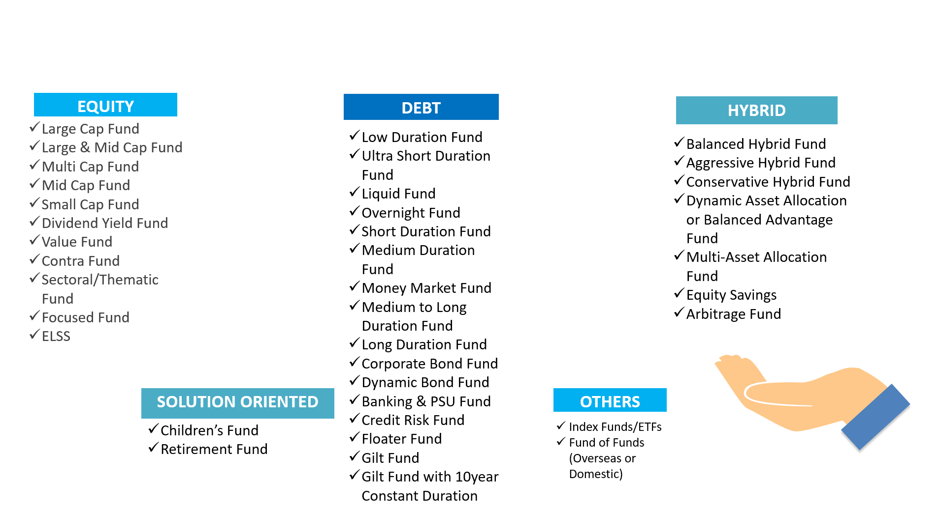
Slide 03
TYPES OF MUTUAL FUND

Slide 4
ABOUT MUTUAL FUNDS
Slide 04
Choosing the Right Fund for Your Goal
Equity Funds
Risk: High
Debt Funds
Risk: Low-Med
Hybrid Funds
Risk: Medium
Invest primarily in stocks. Best for wealth creation over long term.
Invest in bonds & govt. securities. Stable returns, lower risk.
Mix of equity & debt. Good for moderate risk investors.
Ret: 12–15% p.a.*
Ret: 6–8% p.a.*
Ret: 9–11% p.a.*
Ideal: Long-term wealth creation (5+ years)
Ideal: Short to medium term (1–3 years)
Ideal: Balanced approach (3–5 years)
Eg: Mirae Asset Emerging Bluechip, Axis Flexi Cap
Eg: HDFC Short Term Debt Fund, ICICI Gilt Fund
Eg: ICICI Pru Balanced Advantage, Kotak Equity Hybrid
Index Funds
Risk: Market
ELSS Funds
Risk: High
Liquid Funds
Risk: Very Low
Mirrors indices like Nifty 50. Low cost, transparent strategy.
Equity Linked Saving Scheme. Save up to ₹1.5L tax under 80C.
Invests in very short-term instruments. Better than savings a/c.
Ret: Tracks Index
Ret: 12–15% p.a.*
Ret: 4–6% p.a.*
Ideal: Passive, long-term investors
Ideal: Tax saving u/s 80C + wealth creation
Ideal: Emergency corpus / parking surplus cash
Eg: UTI Nifty 50 Index Fund, HDFC Sensex Fund
Eg: Mirae Asset Tax Saver, Axis Long Term Equity
Eg: Nippon India Liquid Fund, Aditya Birla Liquid
*Past returns are not indicative of future performance. Mutual Fund investments are subject to market risks.

Slide 5
POWER OF SIP & COMPOUNDING
Slide 05
Start Early. Stay Consistent. Let Time Work.
What is SIP?
SIP of ₹5,000/month @ 12% p.a. — The Magic of Compounding
Systematic Investment Plan (SIP) lets you invest a fixed amount every month — as low as ₹500. Like a Recurring Deposit, but in mutual funds with potentially higher returns.
Duration
Amount Invested
Estimated Value
Gain
5 Years
₹3,00,000
₹4,12,431
₹1,12,431
10 Years
₹6,00,000
₹11,61,695
₹5,61,695
Key Benefits of SIP
15 Years
₹9,00,000
₹25,22,879
₹16,22,879
✔ Rupee Cost Averaging — buy more units when market is down
20 Years
₹12,00,000
₹49,95,740
₹37,95,740
✔ No need to time the market
25 Years
₹15,00,000
₹94,88,186
₹79,88,186
✔ Builds financial discipline automatically
✔ Can be started/stopped/paused anytime
*Estimates based on 12% annual returns. Actual returns may vary. Past performance is not a guarantee.

Slide 6
GOAL-BASED INVESTING
Slide 06
Every Dream Has a Fund — Let's Match Yours
🏠 Buy a Home
🎓 Child's Education
💍 Child's Wedding
⏱ Horizon:
7–10 Years
⏱ Horizon:
10–15 Years
⏱ Horizon:
15–20 Years
💰 Target:
₹50–80 Lakh
💰 Target:
₹30–50 Lakh
💰 Target:
₹20–40 Lakh
📈 SIP Needed:
₹15,000–25,000/mo
📈 SIP Needed:
₹7,000–12,000/mo
📈 SIP Needed:
₹4,000–8,000/mo
🏦 Fund Type:
Aggressive Hybrid / Large Cap
🏦 Fund Type:
Flexi Cap / Mid Cap
🏦 Fund Type:
Multi Cap / Balanced
🌴 Retirement
✈️ Vacation / Travel
🛡️ Emergency Fund
⏱ Horizon:
20–30 Years
⏱ Horizon:
1–3 Years
⏱ Horizon:
Ongoing
💰 Target:
₹1–2 Crore
💰 Target:
₹2–5 Lakh
💰 Target:
6 Months Expenses
📈 SIP Needed:
₹10,000–20,000/mo
📈 SIP Needed:
₹5,000–10,000/mo
📈 SIP Needed:
₹2,000–5,000/mo
🏦 Fund Type:
Index Fund + ELSS
🏦 Fund Type:
Debt / Liquid Funds
🏦 Fund Type:
Liquid / Ultra-Short Debt
Amounts are approximate and for illustration only. Please consult your distributor for personalised planning. Mutual Fund investments are subject to market risks.

Slide 7
WHY INVEST
Get Started Today
WITH US?
KG
✅ AMFI Certified — ARN 353508
📊 MBA-Finance + NISM VA & XV qualified
🤝 Personalised goal-based investment plans
📱 100% paperless, digital onboarding
Kunal Gupta
🔔 Regular portfolio review & rebalancing
AMFI Registered Mutual Fund Distributor
📞 8434463048
🇮🇳 Serving clients across India
✉️ Kunalkr.gupta5@gmail.com
"Plan Today, Prosper Tomorrow" — Kunal Gupta
🪪 ARN – 353508
Mutual Fund investments are subject to market risks. Read all scheme related documents carefully before investing.

